Slide 1
Programming for Big Data
Lecture 12 in Programming for Big Data module
Lecture 2
Statistics in R
Higher Diploma in Data Analytics (On-line)
Dr Eugene O’Loughlin
eoloughlin@ncirl.ie
01-4498561
Notes:
Material mosyl

Slide 2

Lecture 12 - Objectives
At the end of this section you should be able to:
Use R to:
Calculate a range of descriptive statistics
Perform Student’s t Test (Unpaired)
Perform Student’s t Test (Paired)
Perform an ANOVA test
Perform a Chi Square test

Slide 3


Reading
Teetor P. (2011), R Cookbook, O’Reilly Media, [ISBN: 0596809158]
Stinerock, R. (2018), Statistics with R: A Beginner’s Guide. Sage.[ISBN: 978-1-4739-2489-5]

Slide 4
Statistics with R
R – extremely powerful, highly versatile, widely used
Strengths
Statistical modelling
Graphical presentations
User-defined functions
R has gained wide acceptance among statisticians and data scientists in:
Industry
Academia
Research organizations
Public sectors
Stinerock (2018)

Slide 5

Descriptive Statistics
Descriptive statistics for Sepal Length (Iris data set)
> mean(iris$Sepal.Length)
> median(iris$Sepal.Length)
> max(iris$Sepal.Length)
> min(iris$Sepal.Length)
> range(iris$Sepal.Length)
> diff(range(iris$Sepal.Length) > var(iris$Sepal.Length)
> sd(iris$Sepal.Length))
> kurtosis(iris$Sepal.Length)
> skewness(iris$Sepal.Length)
> summary(iris$Sepal.Length) > summary(iris)
Notes:
Already done!

Slide 6
Linear Model
Simple Linear Regression (Winnipeg apartments data set)
> aptModel <- lm(price ~ sqft, data = aptData)
> aptModel
Call:
lm(formula = price ~ sqft, data = aptData)
Residuals:
Min 1Q Median 3Q Max
-62493 -19091 4645 28254 65746
Coefficients:
Estimate Std. Error t value Pr(>|t|)
(Intercept) 99384.55 39233.54 2.533 0.02627 *
sqft 138.37 35.39 3.910 0.00207 **
---
Signif. codes: 0 ‘***’ 0.001 ‘**’ 0.01 ‘*’ 0.05 ‘.’ 0.1 ‘ ’ 1
Residual standard error: 39510 on 12 degrees of freedom
Multiple R-squared: 0.5602, Adjusted R-squared: 0.5236
F-statistic: 15.29 on 1 and 12 DF, p-value: 0.002073138.4
Notes:
Includes correlation.
Already done!

Slide 7
Student’s t Test – Unpaired/Independent Samples
Body Dimensions Data Set (bdims.csv)
Is there a significant difference between the mean height of men and the mean height of women?
bodyDims <- read.csv(file="bdims.csv",head=TRUE,sep=",")
maleDims <- subset(bodyDims, sex == 1)
femaleDims <- subset(bodyDims, sex == 0)
t.test(maleDims$hgt, femaleDims$hgt, alternative = "two.sided", paired = FALSE)
Welch Two Sample t-test
data: maleDims$hgt and femaleDims$hgt
t = 21.059, df = 494.73, p-value < 2.2e-16
alternative hypothesis: true difference in means is not equal to 0
95 percent confidence interval:
11.67201 14.07406
sample estimates:
mean of x mean of y
177.7453 164.8723
Notes:
t Crit = 1.965
Mean Heights
Men: 177.7453
Women: 164.8723

Slide 8
Student’s t Test – Unpaired/Independent Samples
Body Dimensions Data Set (bdims.csv)
Is there a significant difference between the mean age of men and the mean age of women?
t.test(maleDims$age, femaleDims$age, alternative = "two.sided", paired = FALSE)
Welch Two Sample t-test
data: maleDims$age and femaleDims$age
t = 3.4194, df = 487.96, p-value = 0.0006802
alternative hypothesis: true difference in means is not equal to 0
95 percent confidence interval:
1.233104 4.564467
sample estimates:
mean of x mean of y
31.66802 28.76923
Notes:
T crit = 1.965
Mean Ages
Men: 31.67
Women: 28.77

Slide 9
Student’s t Test – Paired/Dependent Samples
USA Poverty (1990 vs 1998) Data Set (PovertyUSA.csv)
Are mean rates of poverty in the United States lower in 1998 compared to 1990?
t.test(povertyUSA$Data.1998, povertyUSA$Data.1990, alternative = "less", paired = TRUE)
Paired t-test
data: povertyUSA$Data.1998 and povertyUSA$Data.1990
t = -2.339, df = 50, p-value = 0.01169
alternative hypothesis: true difference in means is less than 0
95 percent confidence interval:
-Inf -0.2495953
sample estimates:
mean of the differences
-0.8803922
Notes:
T crit = 1.675
Means
1990: 13.282
1998: 12.401

Slide 10
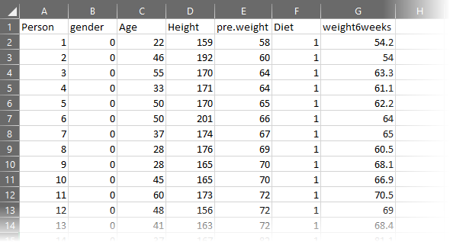
One-way ANOVA
Compare three diet plans for weight loss (diet.csv)
Data source: https://bioinformatics-core-shared-training.github.io/linear-models-r/ANOVA.html

Slide 11
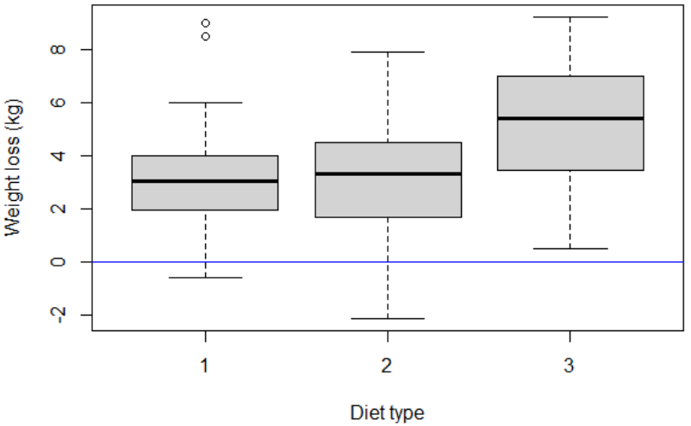
ANOVA: diets comparison
Three diet types (1, 2, and 3)
Read data and calculate weight loss
Visualize
dietData = read.csv(file="diet.csv", header = TRUE, sep = ",")
head(dietData)
dietData$weight.loss <- dietData$pre.weight - dietData$weight6weeks
Notes:
boxplot code:
boxplot(dietData$weight.loss ~ dietData$Diet,data=dietData,col="light gray", ylab = "Weight loss (kg)", xlab = "Diet type")
abline(h=0,col="blue")

Slide 12
ANOVA: diets comparison
dietData$Diet is classified as an integer
Coerce to a factor (categorical data)
dietData$Diet <- as.factor(dietData$Diet)

Slide 13
anova() function
Two ways of conducting an ANOVA in R:
Use anova() function with linear model function lm()
anova(lm(dietData$weight.loss ~ dietData$Diet, dietData))
Analysis of Variance Table
Response: dietData$weight.loss
Df Sum Sq Mean Sq F value Pr(>F)
dietData$Diet 2 71.09 35.547 6.1974 0.003229 **
Residuals 75 430.18 5.736
---
Signif. codes: 0 ‘***’ 0.001 ‘**’ 0.01 ‘*’ 0.05 ‘.’ 0.1 ‘ ’ 1
>

Slide 14
aov() function
Perform ANOVA with aov() function:
table <- aov(dietData$weight.loss ~ dietData$Diet,data=dietData)
summary(table)
> summary(table) # ANOVA table
Df Sum Sq Mean Sq F value Pr(>F)
dietData$Diet 2 71.1 35.55 6.197 0.00323 **
Residuals 75 430.2 5.74
---
Signif. codes: 0 ‘***’ 0.001 ‘**’ 0.01 ‘*’ 0.05 ‘.’ 0.1 ‘ ’ 1
>

Slide 15
Chi Square (Goodness of Fit)
Recent traffic data from the Road Safety Authority (Review of Fatal Collisions: January to July 21st 2016) shows the distribution of fatal road accidents in Ireland by day of the week is as follows:
Sunday | Monday | Tuesday | Wednesday | Thursday | Friday | Saturday
12 | 16 | 10 | 11 | 10 | 12 | 18
> chisq.test(c(12,16,10,11,10,12,18), p=c(1/7,1/7,1/7,1/7,1/7,1/7,1/7))
Chi-squared test for given probabilities
data: c(12, 16, 10, 11, 10, 12, 18)
X-squared = 4.5169, df = 6, p-value = 0.6071
>
Notes:
No difference (p > 0.05) in proportion of fatalities for each day of the week.

